Slide 1
Chapter 3: Introduction to SQL

Slide 2
Chapter 3: Introduction to SQL
Overview of The SQL Query Language
Data Definition
Basic Query Structure
Additional Basic Operations
Set Operations
Null Values
Aggregate Functions
Nested Subqueries
Modification of the Database
Notes:
1

Slide 3
History
IBM Sequel language developed as part of System R project at the IBM San Jose Research Laboratory
Renamed Structured Query Language (SQL)
ANSI and ISO standard SQL:
  SQL-86
  SQL-89
  SQL-92
  SQL:1999 (language name became Y2K compliant!)
  SQL:2003
Commercial systems offer most, if not all, standard features, plus varying feature sets and special proprietary features.
  Not all examples here may work on your particular system.

Slide 4
Data Definition Language
Allows the specification of not only a set of relations but also information about each relation, including:
The schema for each relation.
The domain of values associated with each attribute.
Integrity constraints
The set of indices to be maintained for each relations.
Security and authorization information for each relation.
The physical storage structure of each relation on disk.

Slide 5
Domain Types in SQL
char(n). Fixed length character string, with user-specified length n.
varchar(n). Variable length character strings, with user-specified maximum length n.
int. Integer (a finite subset of the integers that is machine-dependent).
smallint. Small integer (a machine-dependent subset of the integer domain type).
numeric(p,d). Fixed point number, with user-specified precision of p digits, with n digits to the right of decimal point.
real, double precision. Floating point and double-precision floating point numbers, with machine-dependent precision.
float(n). Floating point number, with user-specified precision of at least n digits.
More are covered in Chapter 4.

Slide 6
Create Table Construct
An SQL relation is defined using the create table command:
create table r (A₁ D₁,
A₂ D₂, ...,
A_{n} D_{n},
(integrity-constraint₁),
...,
(integrity-constraint_{k}))
  r is the name of the relation
  each A_{i} is an attribute name in the schema of relation r
  D_{i} is the data type of values in the domain of attribute A_{i}
Example:
create table instructor (
ID char(5),
name varchar(20) not null,
dept_name varchar(20),
salary numeric(8,2))
insert into instructor values (‘10211’, ‘Smith’, ‘Biology’, 66000);
insert into instructor values (‘10211’, null, ‘Biology’, 66000); ← Error!!

Slide 7
Integrity Constraints in Create Table
not null
primary key (A₁, ..., A_{n} )
foreign key (A_{m}, ..., A_{n} ) references r
Example: Declare branch_name as the primary key for branch
create table instructor (
ID char(5),
name varchar(20) not null,
dept_name varchar(20),
salary numeric(8,2),
primary key (ID),
foreign key (dept_name) references department)
primary key declaration on an attribute automatically ensures not null

Slide 8
And a Few More Relation Definitions
create table student (
ID varchar(5) primary key,
name varchar(20) not null,
dept_name varchar(20),
tot_cred numeric(3,0),
foreign key (dept_name) references department) );
create table takes (
ID varchar(5) primary key,
course_id varchar(8),
sec_id varchar(8),
semester varchar(6),
year numeric(4,0),
grade varchar(2),
foreign key (ID) references student,
foreign key (course_id, sec_id, semester, year) references section );
create table course (
course_id varchar(8) primary key,
title varchar(50),
dept_name varchar(20),
credits numeric(2,0),
foreign key (dept_name) references department) );

Slide 9

Drop, Delete From, Alter Table
delete from r
  delete from course;
drop table r
  drop table course;
alter table
  alter table r add A D
    where A is the name of the attribute to be added to relation r and D is the domain of A.
    All tuples in the relation are assigned null as the value for the new attribute.
  alter table r drop A
    where A is the name of an attribute of relation r
    Dropping of attribute may not be supported by many databases.

Slide 10
Basic Query Structure
A typical SQL query has the form:
select A₁, A₂, ..., A_{n}
from r₁, r₂, ..., r_{m}
where P
  A_{i} represents an attribute
  R_{i} represents a relation
  P is a predicate.
The result of an SQL query is a relation.
Notes:
2

Slide 11


The select Clause
The select clause list the attributes desired in the result of a query
  corresponds to the projection operation of the relational algebra
Example: find the names of all instructors:
select name
from instructor
NOTE: SQL names are case insensitive (i.e., you may use upper- or lower-case letters.)
  E.g., Name ≡ NAME ≡ name
Notes:
3

Slide 12
The select Clause (Cont.)
SQL allows duplicates in relations as well as in query results.
To force the elimination of duplicates, insert the keyword distinct after select.
Find the names of all departments with instructor, and remove duplicates
select distinct dept_name
from instructor
The keyword all specifies that duplicates not be removed. ← default
select all dept_name
from instructor
Notes:
4

Slide 13
The select Clause (Cont.)
An asterisk in the select clause denotes “all attributes”
select *
from instructor
The select clause can contain arithmetic expressions involving the operation, +, –, ∗, and /, and operating on constants or attributes of tuples.
The query:
select ID, name, salary/12
from instructor
would return a relation that is the same as the instructor relation, except that the value of the attribute salary is divided by 12.
Notes:
5

Slide 14
The where Clause
The where clause specifies conditions that the result must satisfy
  Corresponds to the selection predicate of the relational algebra.
To find all instructors in Comp. Sci. dept with salary > 80000
select name
from instructor
where dept_name = ‘Comp. Sci.' and salary > 80000
Comparison results can be combined using the logical connectives and, or, and not.
Comparisons can be applied to results of arithmetic expressions.
Notes:
6

Slide 15
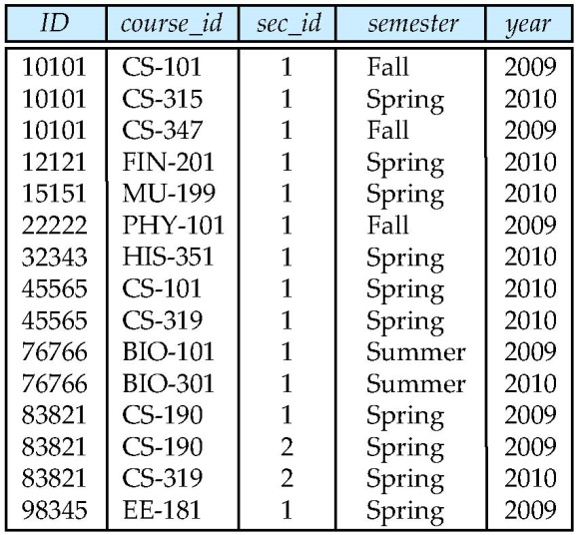
The from Clause
The from clause lists the relations involved in the query
  Corresponds to the Cartesian product operation of the relational algebra.
Find the Cartesian product instructor X teaches
select ∗
from instructor, teaches
  generates every possible instructor – teaches pair, with all attributes from both relations.
Cartesian product not very useful directly, but useful combined with where-clause condition (selection operation in relational algebra).
Notes:
8

Slide 16

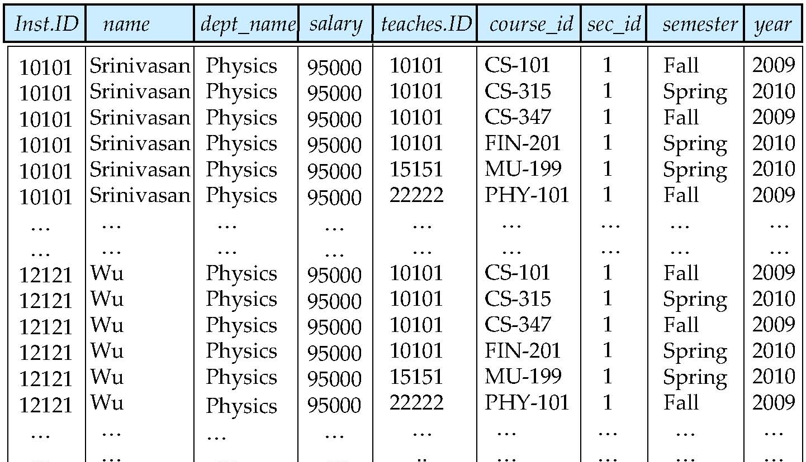
Cartesian Product
instructor
teaches

Slide 17
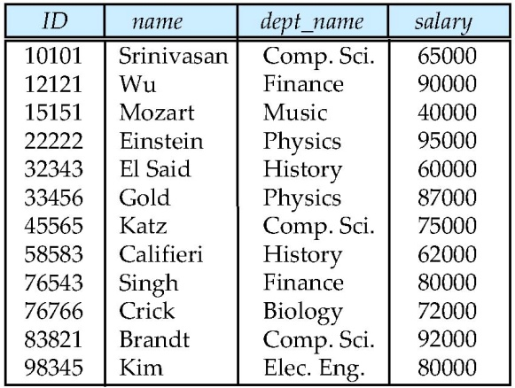
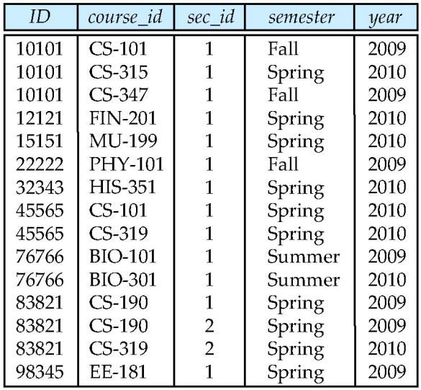

Joins
For all instructors who have taught courses, find their names and the course ID of the courses they taught.
select name, course_id
from instructor, teaches
where instructor.ID = teaches.ID
Find the course ID, semester, year and title of each course offered by the Comp. Sci. department
select section.course_id, semester, year, title
from section, course
where section.course_id = course.course_id
and dept_name = ‘Comp. Sci.'

Slide 18

Natural Join
Natural join matches tuples with the same values for all common attributes, and retains only one copy of each common column
select *
from instructor natural join teaches;

Slide 19
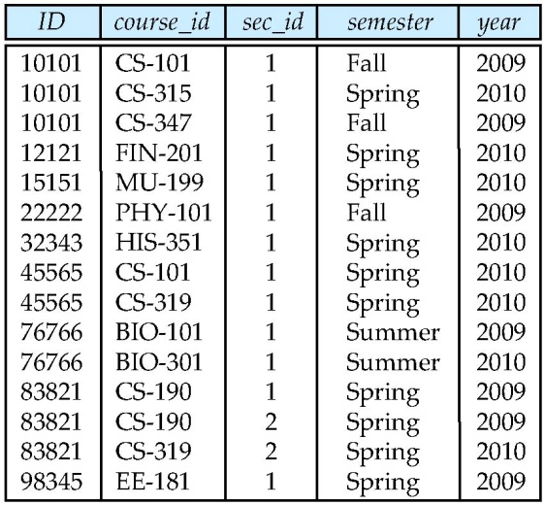
Natural Join (Cont.)
Danger in natural join: beware of unrelated attributes with same name which get equated incorrectly
List the names of instructors along with the titles of courses that they teach
Incorrect version (equates course.dept_name with instructor.dept_name)
  select name, title
  from instructor natural join teaches natural join course;
Correct version
  select name, title
  from instructor natural join teaches, course
  where teaches.course_id= course.course_id;
Another correct version
  select name, title
  from (instructor natural join teaches) join course using(course_id);

Slide 20
The Rename Operation
The SQL allows renaming relations and attributes using the as clause:
old-name as new-name
E.g.,
  select ID, name, salary/12 as monthly_salary
  from instructor
Find the names of all instructors who have a higher salary than
some instructor in ‘Comp. Sci’.
  select distinct T. name
  from instructor as T, instructor as S
  where T.salary > S.salary and S.dept_name = ‘Comp. Sci.’
Keyword as is optional and may be omitted
instructor as T → instructor T
Notes:
9

Slide 21
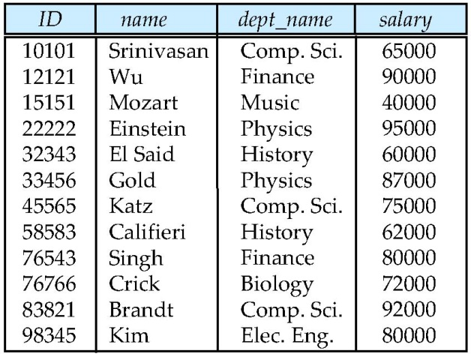
String Operations
SQL includes a string-matching operator for comparisons on character strings. The operator “like” uses patterns that are described using two special characters:
  percent (%): The % character matches any substring.
  underscore (_): The _ character matches any character.
Find the names of all instructors whose name includes the substring “zar”.
select name
from instructor
where name like '%zar%'
Match the string “100 %”
like ‘100 \%' escape '\'
SQL supports a variety of string operations such as
  concatenation (using “||”)
  converting from upper to lower case (and vice versa)
  finding string length, extracting substrings, etc.

Slide 22
Ordering the Display of Tuples
List in alphabetic order the names of all instructors
select distinct name
from instructor
order by name
We may specify desc for descending order or asc for ascending order, for each attribute; ascending order is the default.
  Example: order by name desc
Can sort on multiple attributes
  Example: order by dept_name, name

Slide 23
Where Clause Predicates
SQL includes a between comparison operator
  Example: Find the names of all instructors with salary between $90,000 and $100,000 (that is, ≥ $90,000 and ≤ $100,000)
    select name
    from instructor
    where salary between 90000 and 100000
Tuple comparison
  select name, course_id
  from instructor, teaches
  where instructor.ID = teaches.ID and dept_name = ’Biology’;
  the same
  select name, course_id
  from instructor, teaches
  where (instructor.ID, dept_name) = (teaches.ID, ’Biology’);
Notes:
7

Slide 24

Set Operations
Find courses that ran in Fall 2009 or in Spring 2010
(select course_id from section where semester = ‘Fall’ and year = 2009)
union
(select course_id from section where semester = ‘Spring’ and year = 2010)
Find courses that ran in Fall 2009 and in Spring 2010
(select course_id from section where semester = ‘Fall’ and year = 2009)
intersect
(select course_id from section where semester = ‘Spring’ and year = 2010)
Find courses that ran in Fall 2009 but not in Spring 2010
(select course_id from section where semester = ‘Fall’ and year = 2009)
except
(select course_id from section where semester = ‘Spring’ and year = 2010)

Slide 25
Set Operations
Set operations union, intersect, and except
  Each of the above operations automatically eliminates duplicates
To retain all duplicates use the corresponding multiset versions
  union all, intersect all, except all

Slide 26
Null Values
It is possible for tuples to have a null value, denoted by null, for some of their attributes
null signifies an unknown value or that a value does not exist.
The result of any arithmetic expression involving null is null
  Example: 5 + null returns null
The predicate is null can be used to check for null values.
  Example: Find all instructors whose salary is null.
select name
from instructor
where salary is null

Slide 27
Unknown and Three Valued Logic
Any comparison with null returns unknown
  Example: 5 < null or null <> null or null = null
Three-valued logic using the truth value unknown:
  OR: (unknown or true) = true,
  (unknown or false) = unknown
  (unknown or unknown) = unknown
  AND: (true and unknown) = unknown,
  (false and unknown) = false,
  (unknown and unknown) = unknown
  NOT: (not unknown) = unknown
  “P is unknown” evaluates to true if predicate P evaluates to unknown
Result of where clause predicate is treated as false if it evaluates to unknown

Slide 28
Aggregate Functions
These functions operate on the multiset of values of a column of a relation, and return a value
avg: average value
min: minimum value
max: maximum value
sum: sum of values
count: number of values

Slide 29
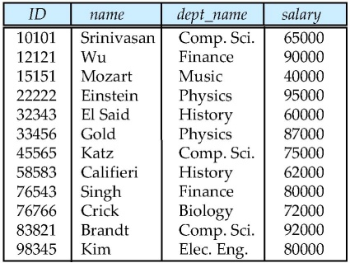
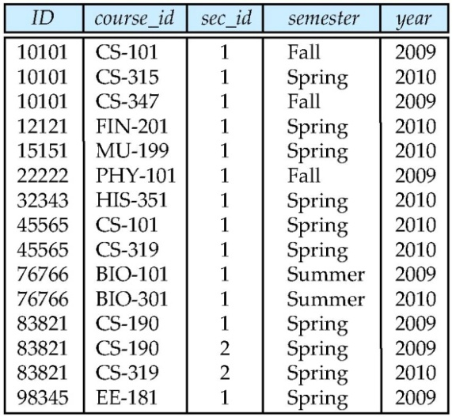
Aggregate Functions (Cont.)
Find the average salary of instructors in the Computer Science department
  select avg (salary)
  from instructor
  where dept_name= ’Comp. Sci.’;
Find the total number of instructors who teach a course in the Spring 2010 semester
  select count (distinct ID)
  from teaches
  where semester = ’Spring’ and year = 2010
Find the number of tuples in the course relation
  select count (*)
  from course;

Slide 30


Aggregate Functions – Group By
Find the average salary of instructors in each department
  select dept_name, avg (salary) as avg_salary
  from instructor
  group by dept_name;
avg_salary

Slide 31
Aggregation (Cont.)
Attributes in select clause outside of aggregate functions must appear in group by list
  /* erroneous query */
  select dept_name, ID, avg (salary)
  from instructor
  group by dept_name;

Slide 32
Aggregate Functions – Having Clause
Find the names and average salaries of all departments whose average salary is greater than 42000
select dept_name, avg (salary)
from instructor
group by dept_name
having avg (salary) > 42000;
Note: predicates in the having clause are applied after the
formation of groups

Slide 33
Null Values and Aggregates
Total all salaries
select sum (salary )
from instructor
  Above statement ignores null amounts
  Result is null if there is no non-null amount
All aggregate operations except count(*) ignore tuples with null values on the aggregated attributes
What if collection has only null values?
  count returns 0
  all other aggregates return null

Slide 34
Nested Subqueries
SQL provides a mechanism for the nesting of subqueries.
A subquery is a select-from-where expression that is nested within another query.
A common use of subqueries is to perform tests for set membership, set comparisons, and set cardinality.

Slide 35

Example Query
Find courses offered in Fall 2009 and in Spring 2010
select distinct course_id
from section
where semester = ’Fall’ and year= 2009 and
course_id in (select course_id
from section
where semester = ’Spring’ and year= 2010);
Find courses offered in Fall 2009 but not in Spring 2010
select distinct course_id
from section
where semester = ’Fall’ and year= 2009 and
course_id not in (select course_id
from section
where semester = ’Spring’ and year= 2010);

Slide 36
Example Query
Find the total number of (distinct) students who have taken course sections taught by the instructor with ID 10101
select count (distinct ID)
from takes
where (course_id, sec_id, semester, year) in
(select course_id, sec_id, semester, year
from teaches
where teaches.ID= 10101);
Note: Above query can be written in a much simpler manner. The
formulation above is simply to illustrate SQL features.

Slide 37
Set Comparison
Find names of instructors with salary greater than that of some (at least one) instructor in the Biology department.
select distinct T.name
from instructor as T, instructor as S
where T.salary > S.salary and S.dept name = ’Biology’;
Same query using > some clause
select name
from instructor
where salary > some (select salary
from instructor
where dept name = ’Biology’);

Slide 38
Definition of Some Clause
F <comp> some r ⇔ ∃ t ∈ r such that (F <comp> t )
Where <comp> can be: <, ≤, >, =, ≠
0
(5 < some
5
) = true
(read: 5 < some tuple in the relation)
6
0
(5 < some
5
) = false
0
(5 = some
) = true
5
0
(5 ≠ some
5
) = true (since 0 ≠ 5)
(= some) ≡ in
However, (≠ some) ≡ not in

Slide 39
Example Query
Find the names of all instructors whose salary is greater than the salary of all instructors in the Biology department.
select name
from instructor
where salary > all (select salary
from instructor
where dept name = ’Biology’);

Slide 40
Definition of all Clause
F <comp> all r ⇔ ∀ t ∈ r (F <comp> t)
0
(5 < all
5
) = false
6
6
(5 < all
) = true
10
4
(5 = all
) = false
5
4
(5 ≠ all
) = true (since 5 ≠ 4 and 5 ≠ 6)
6
(≠ all) ≡ not in
However, (= all) ≡ in

Slide 41
Test for Empty Relations
The exists construct returns the value true if the argument subquery is nonempty.
exists r ⇔ r ≠ Ø
not exists r ⇔ r = Ø

Slide 42
Correlation Variables
Yet another way of specifying the query “Find all courses taught in both the Fall 2009 semester and in the Spring 2010 semester”
select course_id
from section as S
where semester = ’Fall’ and year= 2009 and
exists (select *
from section as T
where semester = ’Spring’ and year= 2010
and S.course_id= T.course_id);
Correlated subquery
Correlation variable

Slide 43
Not Exists
Find all students who have taken all courses offered in the Biology department.
select distinct S.ID, S.name
from student as S
where not exists ( (select course_id
from course
where dept_name = ’Biology’)
except
(select T.course_id
from takes as T
where S.ID = T.ID));
Note: Cannot write this query using = all and its variants

Slide 44
Test for Absence of Duplicate Tuples
The unique construct tests whether a subquery has any duplicate tuples in its result or not.
Find all courses that were offered at most once in 2009
  select T.course_id
  from course as T
  where unique (select R.course_id
  from section as R
  where T.course_id= R.course_id
  and R.year = 2009);

Slide 45
Derived Relations
SQL allows a subquery expression to be used in the from clause
Find the average instructors’ salaries of those departments where the average salary is greater than $42,000.”
  select dept_name, avg_salary
  from (select dept_name, avg (salary) as avg_salary
  from instructor
  group by dept_name)
  where avg_salary > 42000;
Note that we do not need to use the having clause
Another way to write above query
  select dept_name, avg_salary
  from (select dept_name, avg (salary)
  from instructor
  group by dept_name) as dept_avg (dept_name, avg_salary)
  where avg_salary > 42000;

Slide 46
Derived Relations (Cont.)
And yet another way to write it: lateral clause
  select name, salary, avg_salary
  from instructor I1, lateral (select avg(salary) as avg_salary
  from instructor I2
  where I2.dept_name= I1.dept_name);
SQL 2003

Slide 47

With Clause
The with clause provides a way of defining a temporary view whose definition is available only to the query in which the with clause occurs.
Find all departments with the maximum budget
with max_budget (value) as
(select max(budget)
from department)
select dept_name, budget
from department, max_budget
where department.budget = max_budget.value;

Slide 48
Complex Queries using With Clause
Find all departments where the total salary is greater than the average of the total salary at all departments
with dept _total (dept_name, value) as
(select dept_name, sum(salary)
from instructor
group by dept_name),
dept_total_avg(value) as
(select avg(value)
from dept_total)
select dept_name
from dept_total, dept_total_avg
where dept_total.value >= dept_total_avg.value;

Slide 49
Scalar Subquery
select dept_name,
(select count(*)
from instructor
where department.dept_name = instructor.dept_name)
as num_instructors
from department;

Slide 50
Modification of the Database – Deletion
Delete all instructors
delete from instructor
Delete all instructors from the Finance department
delete from instructor
where dept_name= ’Finance’;
Delete all tuples in the instructor relation for those instructors associated with a department located in the Watson building.
delete from instructor
where dept name in (select dept name
from department
where building = ’Watson’);

Slide 51
Example Query
Delete all instructors whose salary is less than the average salary of instructors
delete from instructor
where salary < (select avg (salary) from instructor);
  Problem: as we delete tuples from instructor, the average salary changes
  Solution used in SQL:
  1. First, compute avg salary and find all tuples to delete
  2. Next, delete all tuples found above (without
  recomputing avg or retesting the tuples)

Slide 52
Modification of the Database – Insertion
Add a new tuple to course
insert into course
values (’CS-437’, ’Database Systems’, ’Comp. Sci.’, 4);
or equivalently
insert into course (course_id, title, credits, dept_name)
values (’CS-437’, ’Database Systems’, 4, ’Comp. Sci.’);
Add a new tuple to student with tot_creds set to null
insert into student
values (’3003’, ’Green’, ’Finance’, null);

Slide 53
Modification of the Database – Insertion
Add all instructors to the student relation with tot_creds set to 0
insert into student
select ID, name, dept_name, 0
from instructor
The select from where statement is evaluated fully before any of its results are inserted into the relation (otherwise queries like
insert into table1 select * from table1
would cause problems)

Slide 54
Modification of the Database – Updates
Increase salaries of instructors whose salary is over $100,000 by 3%, and all others receive a 5% raise
  Write two update statements:
  update instructor
  set salary = salary * 1.03
  where salary > 100000;
  update instructor
  set salary = salary * 1.05
  where salary <= 100000;
  The order is important
  Can be done better using the case statement (next slide)

Slide 55
Case Statement for Conditional Updates
Same query as before but with case statement
update instructor
set salary = case
when salary <= 100000 then salary * 1.05
else salary * 1.03
end

Slide 56
Updates with Scalar Subqueries
Recompute and update tot_creds value for all students
update student S
set tot_cred = ( select sum(credits)
from takes natural join course
where S.ID= takes.ID and
takes.grade <> ’F’ and
takes.grade is not null);
Sets tot_cred to null for students who have not taken any course
Instead of “select sum(credits)” clause, use:
case
when sum(credits) is not null then sum(credits)
else 0 ← tot_cred is set to 0 instead of null
end

Slide 57
End of Chapter 3

